Slide 1
International Islamic University Chittagong
Submitted to
Submitted by
Sumayea Benta Hasan Adjunct Faculty Dept of CSE, IIUC
Maryam Tahira-C231519 Nishat Tasnim-C231521 Mallika Barua-C231529

Slide 2

C PROJECT
Cyber Management system

Slide 3
******Overview******
Objective
Motivation
Code picture
Code algorithm
Code output
Advantage
End
Disadvantage

Slide 4
************************************ *******************************
Objective
Developing the registration and management of users information in a cyber environment.
Storing user data and displaying were information.
To manage users information in a cyber environment.
Keeps personal emails and password private.

Slide 5
Motivation
2.Registration of new users and record their details.
1. This project simulate a basic cyber management system.
3.Basic approach to securely managing users data.
4.An opportunity to understand and implement
core programming concepts related tor user management and data persistence in a cyber environment. .

Slide 6
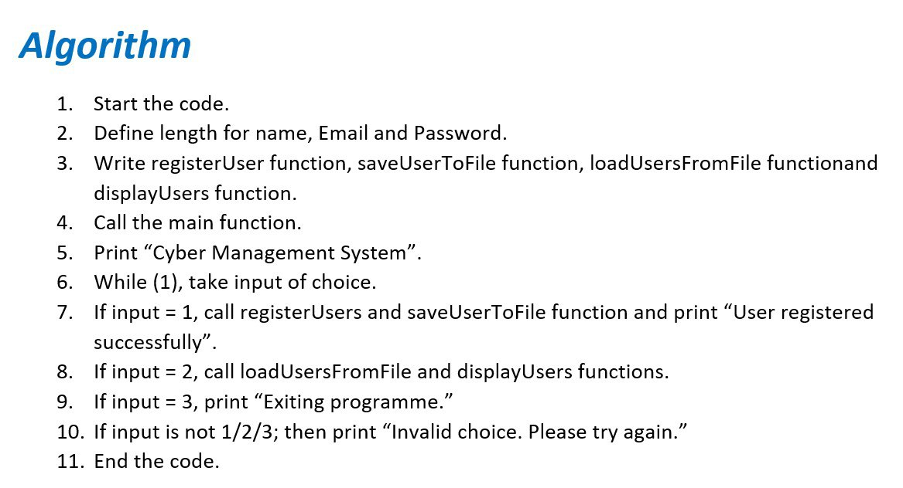
****************************

Slide 7
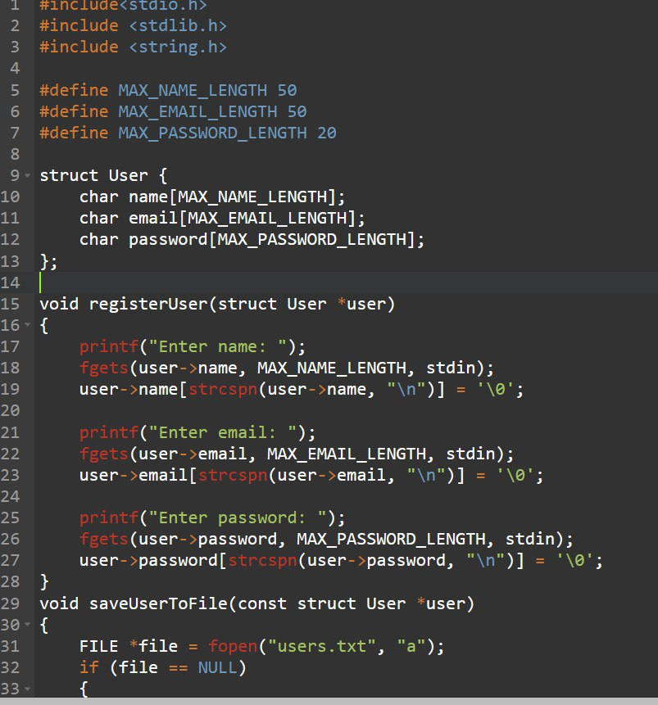
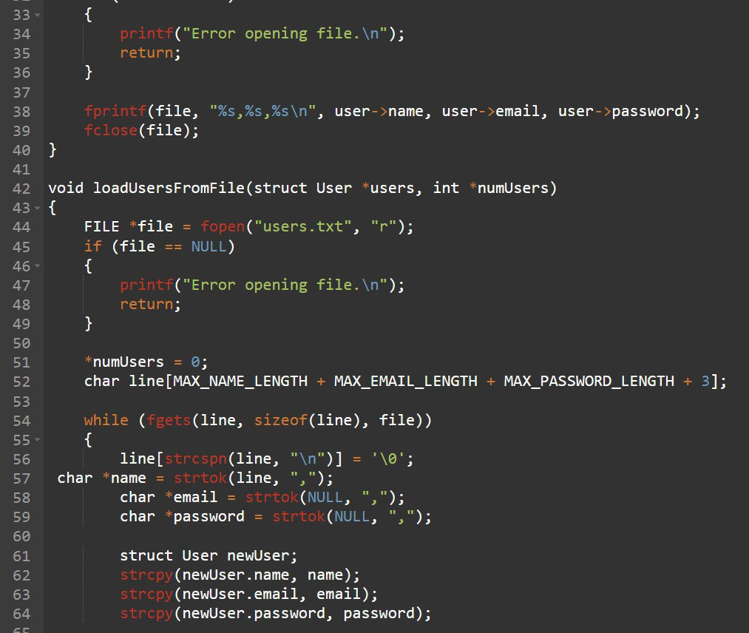
Code

Slide 8
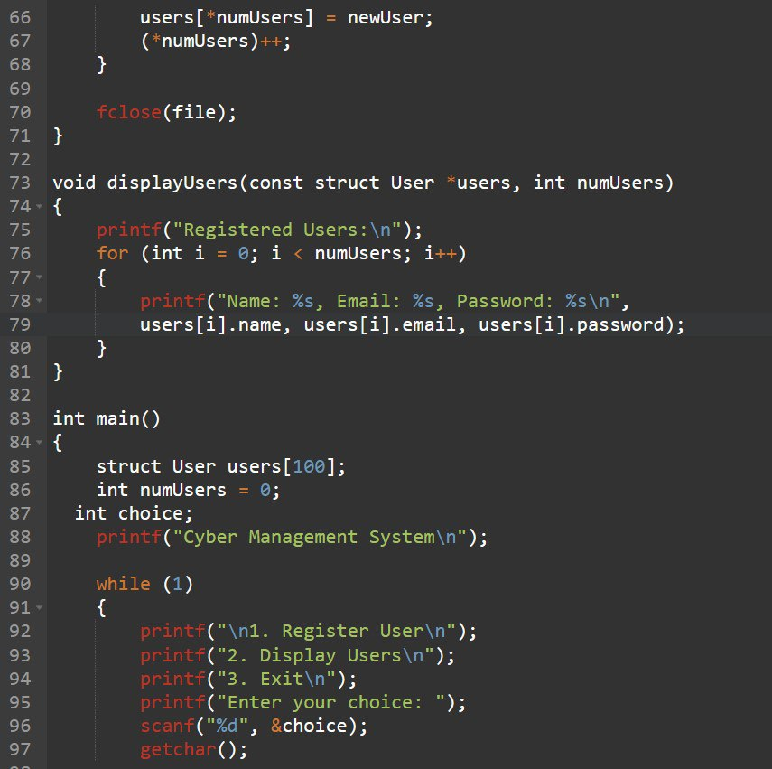
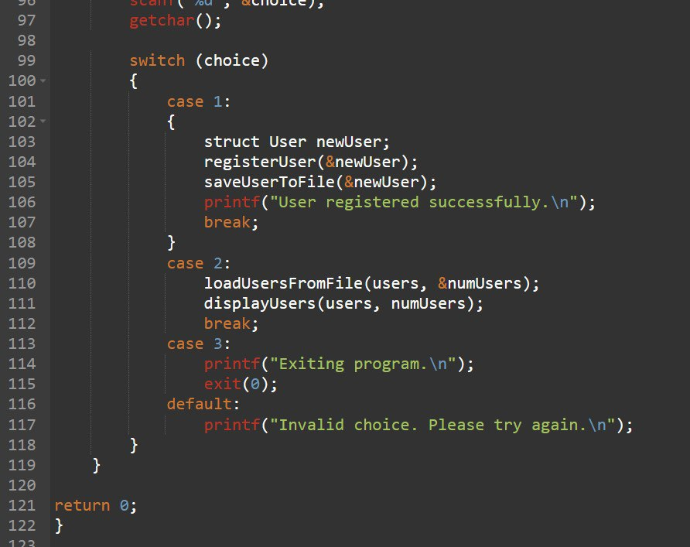
…………………………………………………….

Slide 9
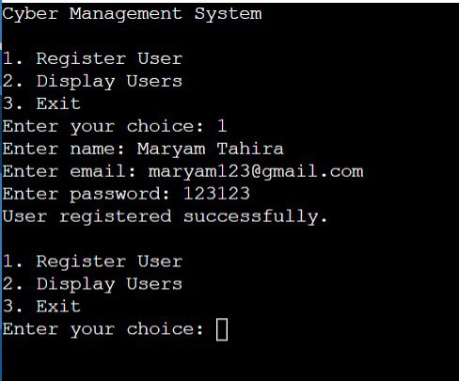
Code Output

Slide 10
Code livelink
https://github.com/tahirasaira/code_for_1st_group_project_c/blob/main/code%20for%20project.c

Slide 11
Advantage
It ensures that the data is persistent and can be accessed even after the program terminates.
We can have an experience in developing a real world application using C programming language as we use multiple concepts of programming language.
This project provides a structured way to store and retrieve users data.

Slide 12
Disadvantage
This project can not enclose the full range of functionalities in real world cyber management system
It has lack of advanced security features.
This project does not include a graphical user interface which may impact usability and accessibility for non technical users.

Slide 13

…

